Slide 1
Code Mobility : A means of mobile Computing
Components : WHAT ?
  Computational Components- CC (process)
    Process
      Code Segment
      Resource Segment
        Resource Components – RC (data, file, device driver etc)
      Execution Segment
Interactions : WHY?
  Events between two or more components (messages)
  Load balancing, Improve performance, Flexibility (dynamic configuration)
Sites: WHERE?
Execution Environment (EE) -- Provide support for execution of the CC (computational components), speed and memory size provided by EE can be different.

Slide 2
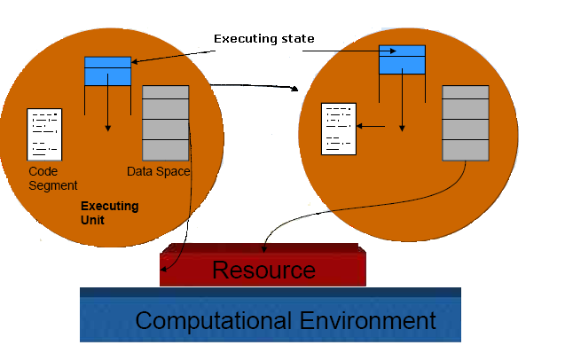
Process Migration

Slide 3
Mobile Code Paradigm
Client – Server Model
Remote Evaluation
Code on Demand
Mobile Agents
Executing Task Baking Cake
Code (Know-How): Recipe
Resource Components (movable resources) : Ingredients
Resource Components (non-movable resource) Oven
Computational Component responsible: A person to mix the
for the execution of the code ingredients in the recipe
Assumption
To prepare the cake (to execute the service) all these elements must be co-located in the same home (site).

Slide 4

Client Server Paradigm
Louise’ House
PLEASE, MAKE ME
A CHOCOLATE CAKE
Christine’s House
  Code:Recipe
  RC
  CC: Christine
A
Request
B
Reply
Site A
Site B

Slide 5

Remote Evaluation
Louise’ House
PLEASE, MAKE ME A
CHOCOLATE CAKE.
HERE IS THE RECIPE:
TAKE TWO EGGS...
Christine’s House
  Code: Recipe
  RC
  CC: Christine
A
Request
B
Reply
Site A
Site B

Slide 6

Code On Demand
Louise’ House
PLEASE, TELL
ME THE RECIPE
Christine’s House
  RC
  CC: Louise
  Recipe
A
Request
B
Reply
Site A
Site B

Slide 7

Mobile Agent
Christine’s House
HERE I AM!
CAN I USE YOUR
OVEN?
Louise
Christine
  RC
Recipe
CC: Louise
A
Move
Site A
Site B

Slide 8
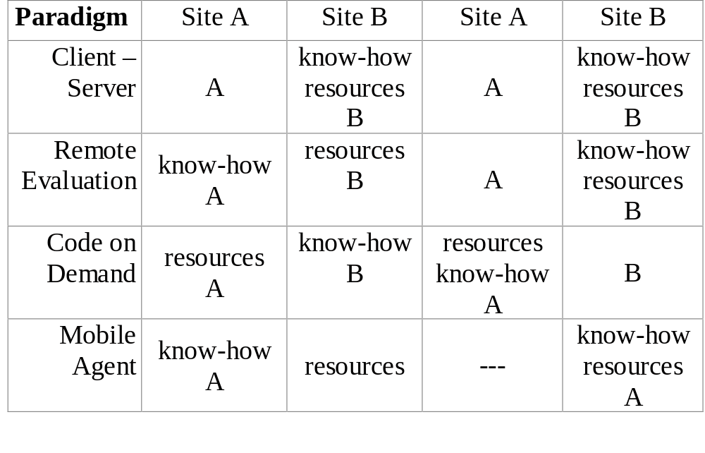
Mobile Code paradigm: At a Glance

Slide 9
Mobile Code
“ Code mobility is the capability to dynamically change the bindings between code fragments and the location where they are executed”
Involves:
  Change in bindings (process to resource & resource-to-machine) dynamically
  Relocation of code

Slide 10
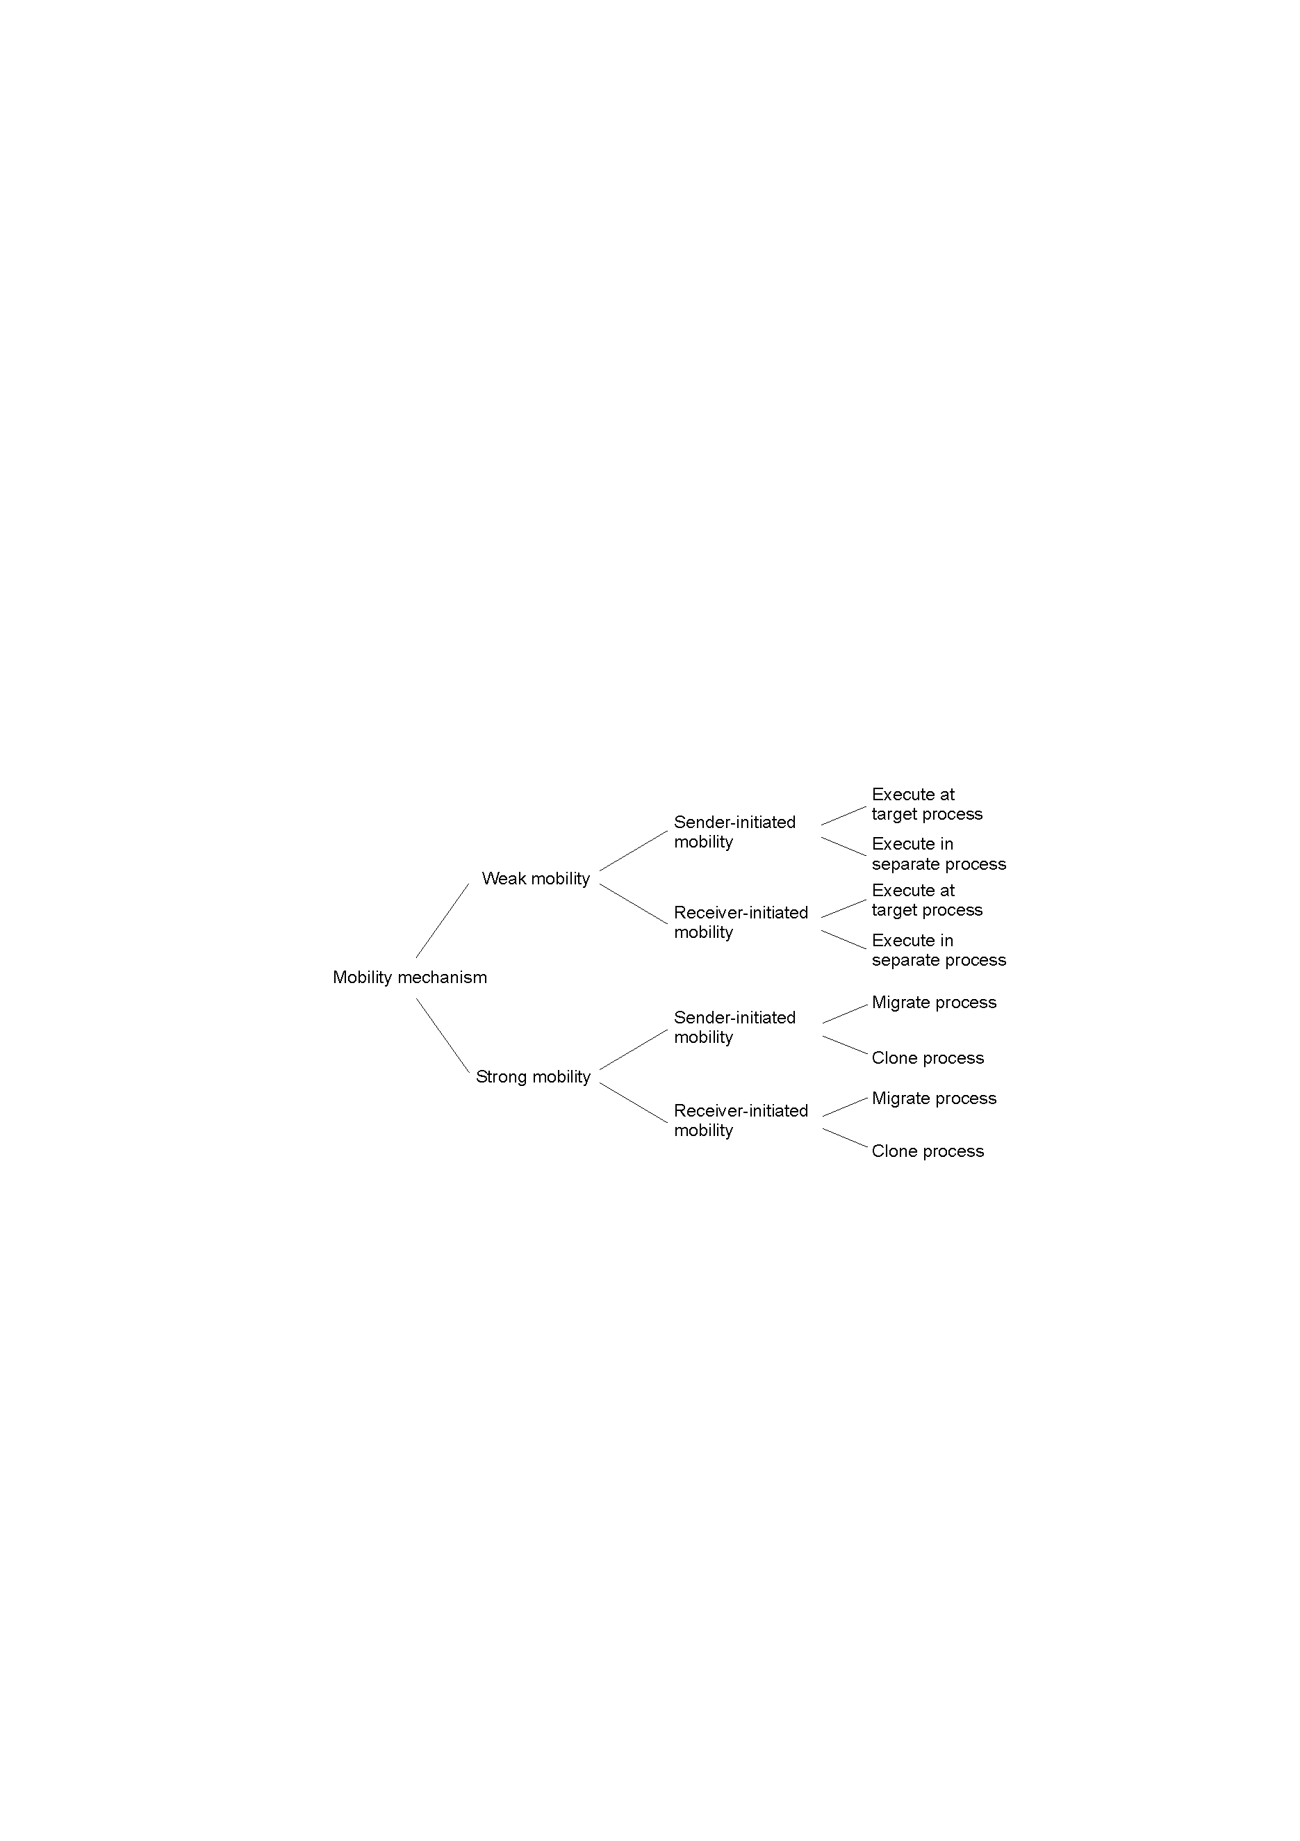
Models of Code Migration

Slide 11
Migration and Local Resources
Resource-to machine binding
 | Unattached | Fastened | Fixed
By identifier By value By type | MV (or GR) CP ( or MV, GR) RB (or GR, CP) | GR (or MV) GR (or CP) RB (or GR, CP) | GR GR RB (or GR)
Process-to-resource binding
Actions to be taken with respect to the references to local resources when migrating code to another machine.
GR: establish global system-wide reference
MV: move the resources
CP: copy the resource
RB: rebind process to locally available resource

Slide 12
s
Migration and Local Resources
Depends on resource to process binding
  By identifier: specific web site, ftp server
  By value: Java libraries
  By type: printers, local devices
Depends on type of “attachments”
  Unattached to any node: data files
  Fastened resources (moved only at high cost)
    Database, web sites
  Fixed resources
    Local devices, communication end points

Slide 13
Resource Management
Distributed systems contain a set of resources interconnected by a network
Processes are migrated to fulfill their resource requirements
Resource manager are to control the assignment of resources to processes
Resources can be logical (shared file) or physical (CPU)
We consider a resource to be a processor

Slide 14
Types of process scheduling techniques
Task assignment approach
  User processes are collections of related tasks
  Tasks are scheduled to improve performance
Load-balancing approach
  Tasks are distributed among nodes so as to equalize the workload of nodes of the system
Load-sharing approach
  Simply attempts to avoid idle nodes while processes wait for being processed

Slide 15
Desirable features of a scheduling algorithm
No A Priori Knowledge about Processes
  User does not want to specify information about characteristic and requirements
Dynamic in nature
  Decision should be based on the changing load of nodes and not on fixed static policy
Quick decision-making capability
  Algorithm must make quick decision about the assignment of task to nodes of system

Slide 16
Desirable features of a scheduling algorithm II.
Balanced system performance and scheduling overhead
  Great amount of information gives more intelligent decision, but increases overhead
Stability
  Unstable when all processes are migrating without accomplishing any useful work
  It occurs when the nodes turn from lightly-loaded to heavily-loaded state and vice versa

Slide 17
Desirable features of a scheduling algorithm III.
Scalability
  A scheduling algorithm should be capable of handling small as well as large networks
Fault tolerance
  Should be capable of working after the crash of one or more nodes of the system
Fairness of Service
  More users initiating equivalent processes expect to receive the same quality of service

Slide 18
Task assignment approach
Main assumptions
  Processes have been split into tasks
  Computation requirement of tasks and speed of processors are known
  Cost of processing tasks on nodes are known
  Communication cost between every pair of tasks are known
  Resource requirements and available resources on node are known
  Reassignment of tasks are not possible

Slide 19
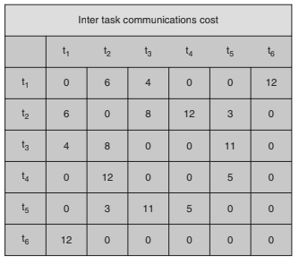
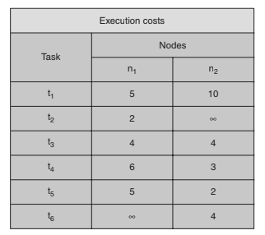

Inter task Communication and Execution Cost

Slide 20
Task assignment approach
Basic idea: Finding an optimal assignment to achieve goals such as the following:
  Minimization of IPC costs
  Quick turnaround time of process
  High degree of parallelism
  Efficient utilization of resources

Slide 21

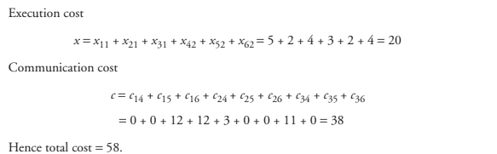

Slide 22
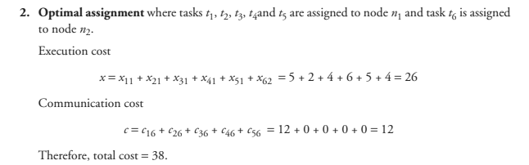
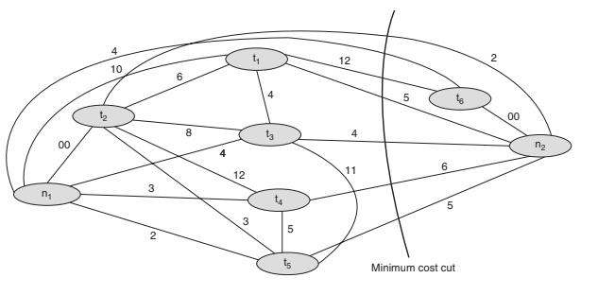

Slide 23
Load-balancing approach
Load-balancing algorithms
Static
Dynamic
Deterministic
Probabilistic
Centralized
Distributed
Cooperative
Noncooperative

Slide 24
Load-balancing approach
Type of load-balancing algorithms
Static versus Dynamic
  Static algorithms ignore the current state or load of the nodes in the system
  Dynamic algorithms collect state information and react to system state if it changed
  Static algorithms are much more simpler
  Dynamic algorithms are able to give significantly better performance

Slide 25
Load-balancing approach
Type of static load-balancing algorithms
Deterministic versus Probabilistic
  Deterministic algorithms use the information about the properties of the nodes and the characteristic of processes to be scheduled
  Probabilistic algorithms use information of static attributes of the system (e.g. number of nodes, processing capability, topology) to formulate simple process placement rules
  Deterministic approach is difficult to optimize
  Probabilistic approach has poor performance

Slide 26
Load-balancing approach
Type of dynamic load-balancing algorithms
Centralized versus Distributed
  Centralized approach collects information to server node and makes decision
  Distributed approach contains entities to make decisions
  Centralized algorithms can make efficient decisions, have lower fault-tolerance
  Distributed algorithms avoid the bottleneck of collecting state information and react faster

Slide 27
Load-balancing approach
Type of distributed load-balancing algorithms
Cooperative versus Noncooperative
  In Noncooperative algorithms entities act as autonomous ones and make scheduling decisions independently
  In Cooperative algorithms distributed entities cooperate with each other
  Cooperative algorithms are more complex and involve larger overhead
  Stability of Cooperative algorithms are better

Slide 28
Issues in designing Load-balancing algorithms
Load estimation policy
  determines how to estimate the workload of a node
Process transfer policy
  determines whether to execute a process locally or remote
Location policy
  determines to which node the transferable process should be sent
State information exchange policy
  determines how to exchange load information among nodes
Priority assignment policy
  determines the priority of execution of local and remote processes
Migration limiting policy
  determines the total number of times a process can migrate

Slide 29
Load estimation policy I. for Load-balancing algorithms
To balance the workload on all the nodes of the system, it is necessary to decide how to measure the workload of a particular node
Some measurable parameters (with time and node dependent factor) can be the following:
  Total number of processes on the node
  Resource demands of these processes
  Instruction mixes of these processes
  Architecture and speed of the node’s processor
Several load-balancing algorithms use the total number of processes to achieve big efficiency

Slide 30
Load estimation policy II. for Load-balancing algorithms
In some cases the true load could vary widely depending on the remaining service time, which can be measured in several way:
  Memoryless method assumes that all processes have the same expected remaining service time, independent of the time used so far
  Pastrepeats assumes that the remaining service time is equal to the time used so far
  Distribution method states that if the distribution service times is known, the associated process’s remaining service time is the expected remaining time conditioned by the time already used

Slide 31
Load estimation policy III. for Load-balancing algorithms
None of the previous methods can be used in modern systems because of periodically running processes and daemons
An acceptable method for use as the load estimation policy in these systems would be to measure the CPU utilization of the nodes
Central Processing Unit utilization is defined as the number of CPU cycles actually executed per unit of real time
It can be measured by setting up a timer to periodically check the CPU state (idle/busy)

Slide 32
Process transfer policy I. for Load-balancing algorithms
Most of the algorithms use the threshold policy to decide on whether the node is lightly-loaded or heavily-loaded
Threshold value is a limiting value of the workload of node which can be determined by
  Static policy: predefined threshold value for each node depending on processing capability
  Dynamic policy: threshold value is calculated from average workload and a predefined constant
Below threshold value node accepts processes to execute, above threshold value node tries to transfer processes to a lightly-loaded node

Slide 33
Process transfer policy II. for Load-balancing algorithms
Single-threshold policy may lead to unstable algorithm because underloaded node could turn to be overloaded right after a process migration
To reduce instability double-threshold policy has been proposed which is also known as high-low policy
Overloaded
Overloaded
High mark
Threshold
Normal
Low mark
Underloaded
Underloaded
Single-threshold policy
Double-threshold policy

Slide 34
Process transfer policy III. for Load-balancing algorithms
Double threshold policy
  When node is in overloaded region new local processes are sent to run remotely, requests to accept remote processes are rejected
  When node is in normal region new local processes run locally, requests to accept remote processes are rejected
  When node is in underloaded region new local processes run locally, requests to accept remote processes are accepted

Slide 35
Location policy I. for Load-balancing algorithms
Threshold method
  Policy selects a random node, checks whether the node is able to receive the process, then transfers the process. If node rejects, another node is selected randomly. This continues until probe limit is reached.
Shortest method
  L distinct nodes are chosen at random, each is polled to determine its load. The process is transferred to the node having the minimum value unless its workload value prohibits to accept the process.

Slide 36
Location policy II. for Load-balancing algorithms
Bidding method
  Nodes contain managers (to send processes) and contractors (to receive processes)
  Managers broadcast a request for bid, contractors respond with bids (prices based on capacity of the contractor node) and manager selects the best offer
  Winning contractor is notified and asked whether it accepts the process for execution or not
  Full autonomy for the nodes regarding scheduling
  Big communication overhead
  Difficult to decide a good pricing policy

Slide 37
Location policy III. for Load-balancing algorithms
Pairing
  Contrary to the former methods the pairing policy is to reduce the variance of load only between pairs
  Each node asks some randomly chosen node to form a pair with it
  If it receives a rejection it randomly selects another node and tries to pair again
  Two nodes that differ greatly in load are temporarily paired with each other and migration starts
  The pair is broken as soon as the migration is over
  A node only tries to find a partner if it has at least two processes

Slide 38
State information exchange policy I. for Load-balancing algorithms
Dynamic policies require frequent exchange of state information, but these extra messages arise two opposite impacts:
  Increasing the number of messages gives more accurate scheduling decision
  Increasing the number of messages raises the queuing time of messages
State information policies can be the following:
  Periodic broadcast
  Broadcast when state changes
  On-demand exchange
  Exchange by polling

Slide 39
State information exchange policy II. for Load-balancing algorithms
Periodic broadcast
  Each node broadcasts its state information after the elapse of every T units of time
  Problem: heavy traffic, fruitless messages, poor scalability since information exchange is too large for networks having many nodes
Broadcast when state changes
  Avoids fruitless messages by broadcasting the state only when a process arrives or departures

Slide 40
State information exchange policy III. for Load-balancing algorithms
On-demand exchange
  In this method a node broadcast a State-Information-Request message when its state switches from normal to either underloaded or overloaded region.
  On receiving this message other nodes reply with their own state information to the requesting node
  Further improvement can be that only those nodes reply which are useful to the requesting node
Exchange by polling
  To avoid poor scalability (coming from broadcast messages) the partner node is searched by polling the other nodes on by one, until poll limit is reached

Slide 41
Priority assignment policy for Load-balancing algorithms
Selfish
  Local processes are given higher priority than remote processes. Worst response time performance of the three policies.
Altruistic
  Remote processes are given higher priority than local processes. Best response time performance of the three policies.
Intermediate
  (L>R) When the number of local processes is greater or equal to the number of remote processes, local processes are given higher priority than remote processes. Otherwise, remote processes are given higher priority than local processes.

Slide 42
Migration limiting policy for Load-balancing algorithms
This policy determines the total number of times a process can migrate
  Uncontrolled
    A remote process arriving at a node is treated just as a process originating at a node, so a process may be migrated any number of times
  Controlled
    Avoids the instability of the uncontrolled policy
    Use a migration count parameter to fix a limit on the number of time a process can migrate
    Irrevocable migration policy: migration count is fixed to 1
    For long execution processes migration count must be greater than 1 to adapt for dynamically changing states

Slide 43
Load-sharing approach
Drawbacks of Load-balancing approach
  Load balancing technique with attempting equalizing the workload on all the nodes is not an appropriate object since big overhead is generated by gathering exact state information
  Load balancing is not achievable since number of processes in a node is always fluctuating and temporal unbalance among the nodes exists every moment.
Basic ideas for Load-sharing approach
  It is necessary and sufficient to prevent nodes from being idle while some other nodes have more than two processes
  Load-sharing is much simpler than load-balancing since it only attempts to ensure that no node is idle when heavily node exists
  Priority assignment policy and migration limiting policy are the same as that for the load-balancing algorithms

Slide 44
Load estimation policies for Load-sharing algorithms
Since load-sharing algorithms simply attempt to avoid idle nodes, it is sufficient to know whether a node is busy or idle.
Thus these algorithms normally employ the simplest load estimation policy of counting the total number of processes.
algorithms measure CPU utilization to estimate the load of a node

Slide 45
Process transfer policies for Load-sharing algorithms
This strategy uses the threshold value of all the nodes fixed to 1
Nodes become receiver node when it has no process, and become sender node when it has more than 1 process
To avoid processing power on nodes having zero process load-sharing algorithms use a threshold value of 2 instead of 1
When CPU utilization is used as the load estimation policy, the double-threshold policy should be used as the process transfer policy

Slide 46
Location policies I. for Load-sharing algorithms
Location policy decides whether the sender node or the receiver node of the process takes the initiative to search for suitable node in the system, and this policy can be the following:
  Sender-initiated location policy
    Sender node decides where to send the process
    Heavily loaded nodes search for lightly loaded nodes
  Receiver-initiated location policy
    Receiver node decides from where to get the process
    Lightly loaded nodes search for heavily loaded nodes

Slide 47
Location policies II. for Load-sharing algorithms
Sender-initiated location policy
  Node becomes overloaded, it either broadcasts or randomly probes the other nodes one by one to find a node that is able to receive remote processes
  When broadcasting, suitable node is known as soon as reply arrives
Receiver-initiated location policy
  Nodes becomes underloaded, it either broadcast or randomly probes the other nodes one by one to indicate its willingness to receive remote processes
  Sender-initiated policy is preferable at light to moderate system loads
  Receiver-initiated policy is preferable at high system loads

Slide 48
State information exchange policies for Load-sharing algorithms
In load-sharing algorithms it is not necessary for the nodes to periodically exchange state information, but needs to know the state of other nodes when it is either underloaded or overloaded
Broadcast when state changes
  In sender-initiated/receiver-initiated location policy a node broadcasts State Information Request when it becomes overloaded/underloaded
Poll when state changes
  In large networks polling mechanism is used
  Polling mechanism randomly asks different nodes for state information until find an appropriate one or probe limit is reached

Slide 49
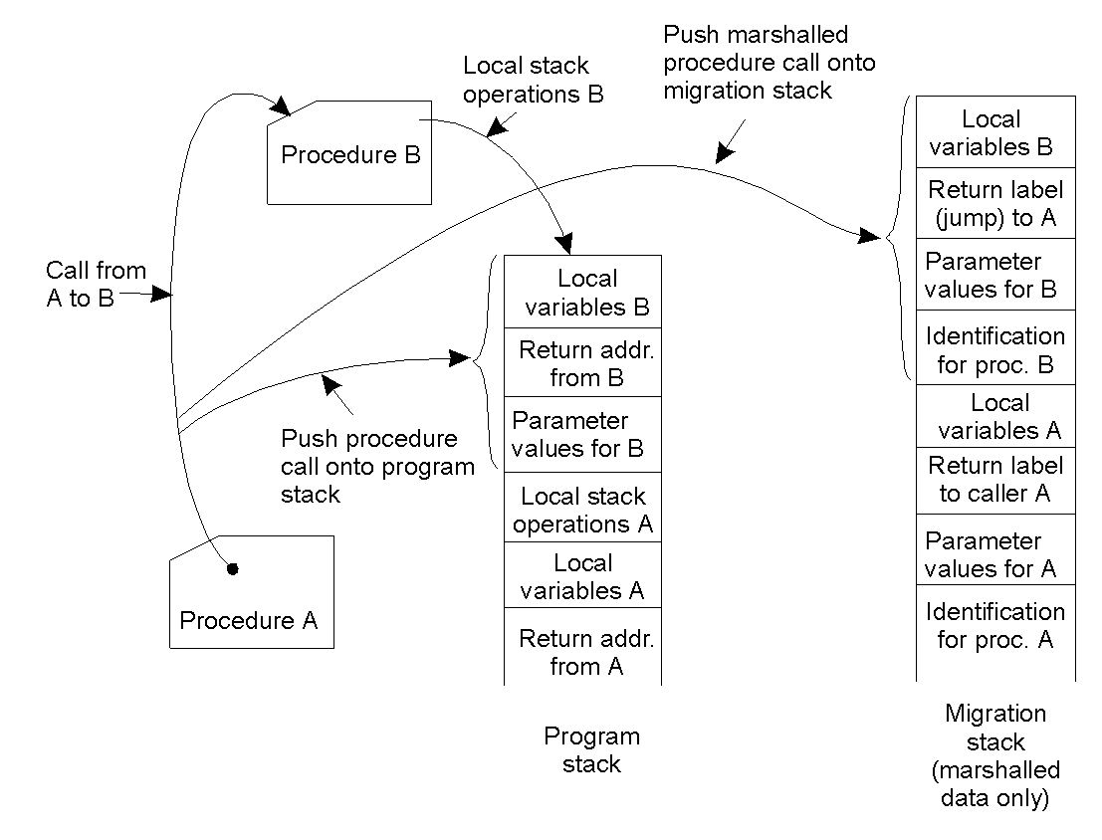
Migration in Heterogeneous Systems
Systems can be heterogeneous (different architecture, OS)
  Support only weak mobility: recompile code, no run time information
  Strong mobility: recompile code segment, transfer execution segment [migration stack]
  Virtual machines - interpret source (scripts) or intermediate code [Java]
Migration on
Only subroutine
Or method
Call
Migrate stack

Slide 50
Cost of migration
Multiprocessor: nondistributed
  loss of the lines associated with the process in the processor's instruction a data caches
Distributed environment
  Moving a process's virtual memory
  Forwarding a process's IPC (local and network) messages, informing senders of the process's new contact information.
  Moving information of files. the open file table, the file descriptor table, the file offset, dirty blocks in the buffer cache, &c
  Moving the process's user-level state: registers, stack, &c
  Moving the process's kernel-level state: pwd, pid, signal masks, &c
Univ. of Tehran
Distributed Operating Systems

Slide 51
Cost of migration (partial migration)
Migration of the whole process too expensive.
Move certain aspects of a process
  The remaining portions of the process create residual dependencies -- the migrated process still relies on the original host to provide the services that were not migrated.
Univ. of Tehran
Distributed Operating Systems

Slide 52
Migrating Virtual memory
Freeze and copy migration: Suspend or freeze the process on the original host, and then to copy all of the pages of memory to the new host. Once all done, process can be resumed on the new host.
  Simple, clean and easy to implement.
  Does not create a residual dependency
  Many pages which are never used may be copied and sent over the network If the process is migrated several times, this cost adds up
  Do nothing while copying?
Univ. of Tehran
Distributed Operating Systems

Slide 53
Migrating Virtual memory
Precopying: The process runs on the original host, while the pages are being copied.
  It is clean -- it does not create any residual dependencies.
  Copying pages that may never be used.
  Dirty pages must be transferred. Can be more expensive
lazy migration: like demand paging.
  It creates residual dependencies
Univ. of Tehran
Distributed Operating Systems

Slide 54
Migrating Virtual memory
Distributed file system: a memory-mapped file. the process's memory can be migrated simply by flushing the dirty blocks and mapping the file from a different host.
  Isn't as clean as it may seem
Univ. of Tehran
Distributed Operating Systems

Slide 55
Migrating Communication Channels
If a process migrates, its communications must be able to continue.
  Inform "interested" processes of the new location of a migrating process.
    Unclean, unnecessary messages, how to know other communicating clients?
  link redirection or forwarding at the original host of the migrating process.
    Residual dependency and can increase the latency involved in sending messages to the migrated process, but makes the process of migration itself cheaper
Univ. of Tehran
Distributed Operating Systems

Slide 56
Process with open files
Show up at the new host and re-open the files. But, in truth, there is a great deal of state associated with an open file. Consider the system-wide open file table, the cached inodes, dirty blocks that may live only in the local buffer cache, &c.
  fork()'d proceses share the same file offset.
it is often much easier to leave the process dependent on the old host for file service.
Univ. of Tehran
Distributed Operating Systems

Slide 57
Migrate kernel state
It is often easier to leave a migrating process dependent on a prior (or perhaps first) host for these services.
Checkpointing and recovery: A process's state to be saved to a file (much like a persistent object) and then a new process to be created (restored) based on this checkpoint file. This checkpoint file contains all of the "goods" including the kernel material.
Univ. of Tehran
Distributed Operating Systems

Slide 58
Migrate? Or not migrate?
Several things to consider
  If the home host suffers from a bursty load, it may not make sense to migrate a process -- the home host will be free again, soon.
  Processes with significant virtual memory or IPC usage or many open files are poor choices for migration.
  Historical consideration: long running processes are better candidates than recent arrivals – they are likely to continue to run for a long time. Short lived processes are likely to complete shortly after migration, offering little gain to amortize the cost of migration over useful work.
Univ. of Tehran
Distributed Operating Systems

Slide 59
Design Issues
Measure of load
  Queue lengths at CPU, CPU utilization
Types of policies
  Static: decisions hardwired into system
  Dynamic: uses load information
  Adaptive: policy varies according to load
Preemptive versus non-preemptive
Centralized versus decentralized
Stability: λ>μ => instability, λ₁+λ₂<μ₁+μ₂=>load balance
  Job floats around and load oscillates
Univ. of Tehran
Distributed Operating Systems

Slide 60
Components
Transfer policy: when to transfer a process?
  Threshold-based policies are common and easy
Selection policy: which process to transfer?
  Prefer new processes
  Transfer cost should be small compared to execution cost
    Select processes with long execution times
Location policy: where to transfer the process?
  Polling, random, nearest neighbor
Information policy: when and from where?
  Demand driven [only if sender/receiver], time-driven [periodic], state-change-driven [send update if load changes]
Univ. of Tehran
Distributed Operating Systems

Slide 61

Sender-initiated Policy
Transfer policy
Selection policy: newly arrived process
Location policy: three variations
  Random: may generate lots of transfers => limit max transfers
  Threshold: probe n nodes sequentially
    Transfer to first node below threshold, if none, keep job
  Shortest: poll N_{p} nodes in parallel
    Choose least loaded node below T
Univ. of Tehran
Distributed Operating Systems

Slide 62
Receiver-initiated Policy
Transfer policy: If departing process causes load < T, find a process from elsewhere
Selection policy: newly arrived or partially executed process
Location policy:
  Threshold: probe up to N_{p} other nodes sequentially
    Transfer from first one above threshold, if none, do nothing
  Shortest: poll n nodes in parallel, choose node with heaviest load above T
Univ. of Tehran
Distributed Operating Systems

Slide 63
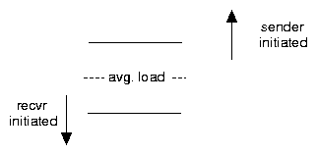

Symmetric Policies
Nodes act as both senders and receivers: combine previous two policies without change
  Use average load as threshold
Improved symmetric policy: exploit polling information
  Two thresholds: LT, UT, LT <= UT
  Maintain sender, receiver and OK nodes using polling info
  Sender: poll first node on receiver list …
  Receiver: poll first node on sender list …
Univ. of Tehran
Distributed Operating Systems

Slide 64
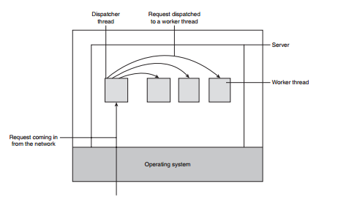
Dispatcher

Slide 65
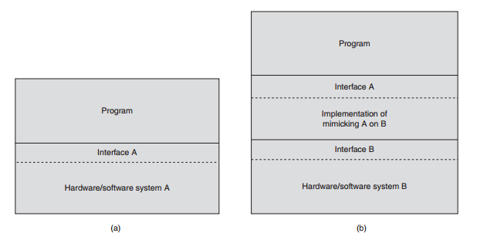

Slide 66
Types of Virtualization
1. We build a runtime system that essentially provides an abstract instruction set used for executing applications.
2. Instructions can be interpreted, could also be emulated as is done for running Windows applications on UNIX platforms.
3. This type of virtualization leads to call a process virtual machine, stressing that virtualization is done essentially only for a single process.
4. An alternative approach towards virtualization is to provide a system that is essentially implemented as a layer completely shielding the original hardware, but offering the complete instruction set of the same (or other hardware) as an interface.
5. It is now possible to have multiple and different operating systems run independently and concurrently on the same platform. The layer is generally referred to as a virtual machine monitor (VMM).

Slide 67
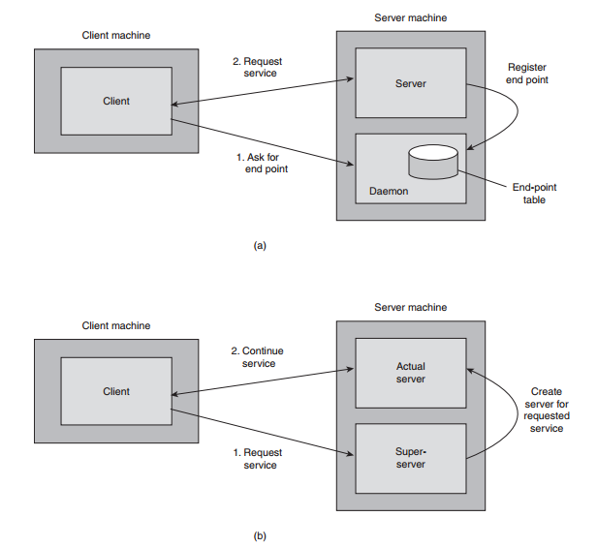
Client Server using daemon / Super server

Slide 68
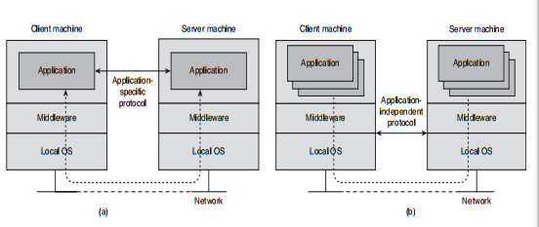
Virtualization

Slide 69
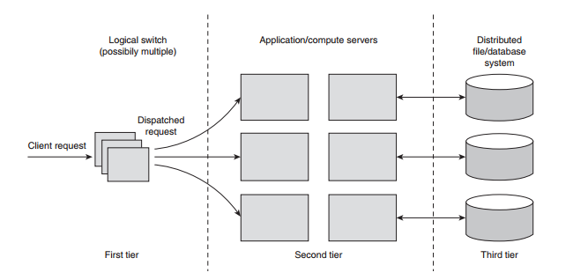
Cluster

